Slide 1
Project Title
Detection of Cars- Computer vision
Objective
Localization and classification of car
Data Source
The data used for this project is based on the Kaggle data set [1] for car detection
Timeline
Mile Stone I
Mile Stone II
Mile Stone III
Images mapped to its class and annotation ready to be used for deep learning
Hybrids based object detection models to impose the bounding box or mask over the area of interest.
Clickable UI based interface

Slide 2
Methodology
Image Preprocessing
Normalization
Augmentation
Normalization by pixel of each image
Normalization of all image
Import necessary python library
UI
Mobilenet
SSD-Mobilenet
Yolo v3 based
EfficientnetB5
Choose directory where data loaded
Model building
IOU: MSE
Categorical accuracy
Load the data
Monitor Loss
Visualize the data
Hyper parameter tuning
Learning rate finder
Cyclic Learning
Progressive unfreezing
Batch Size
EDA
Model evaluation

Slide 3
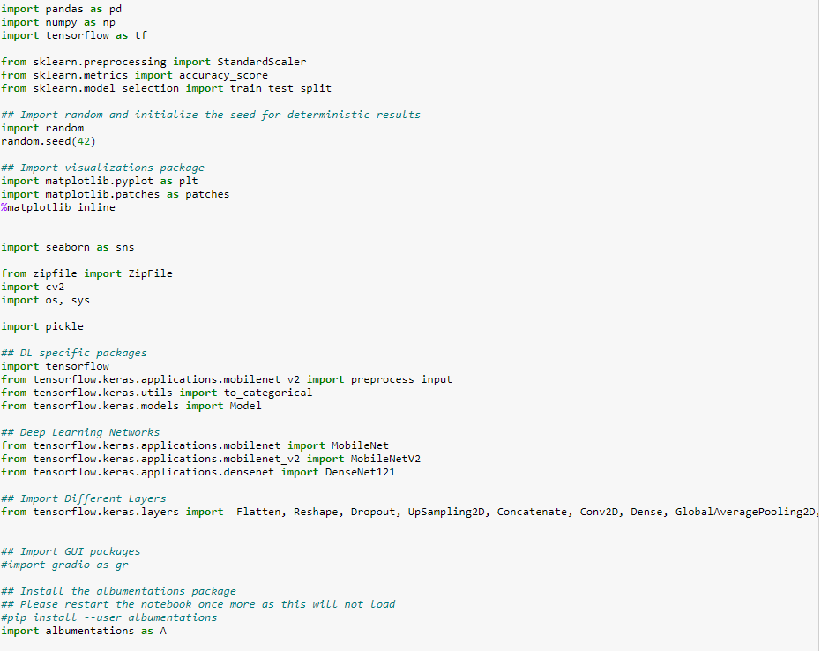
Import Library
Code
Image Preprocessing
Normalization
Augmentation
Normalization by pixel of each image
Normalization of all image
Import necessary python library
UI
VGG16
Mobilenet
EfficientnetB5
EllificentnetB0
Choose directory where data loaded
Model building
Building loss criteria
IOU: MSE
Categorical accuracy
Load the data
Visualize the data
Hyper parameter tunning
Cyclic Learning
Progressive unfreezing
Batch number
EDA
Model evaluation

Slide 4
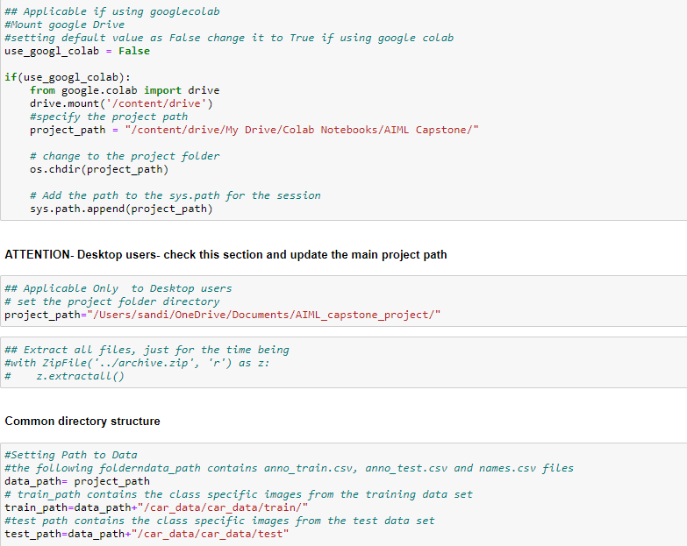
Project Space
Code
Image Preprocessing
Normalization
Augmentation
Normalization by pixel of each image
Normalization of all image
Import necessary python library
UI
VGG16
Mobilenet
EfficientnetB5
EllificentnetB0
Choose directory where data loaded
Model building
Building loss criteria
IOU: MSE
Categorical accuracy
Load the data
Visualize the data
Hyper parameter tunning
Cyclic Learning
Progressive unfreezing
Batch number
EDA
Model evaluation

Slide 5
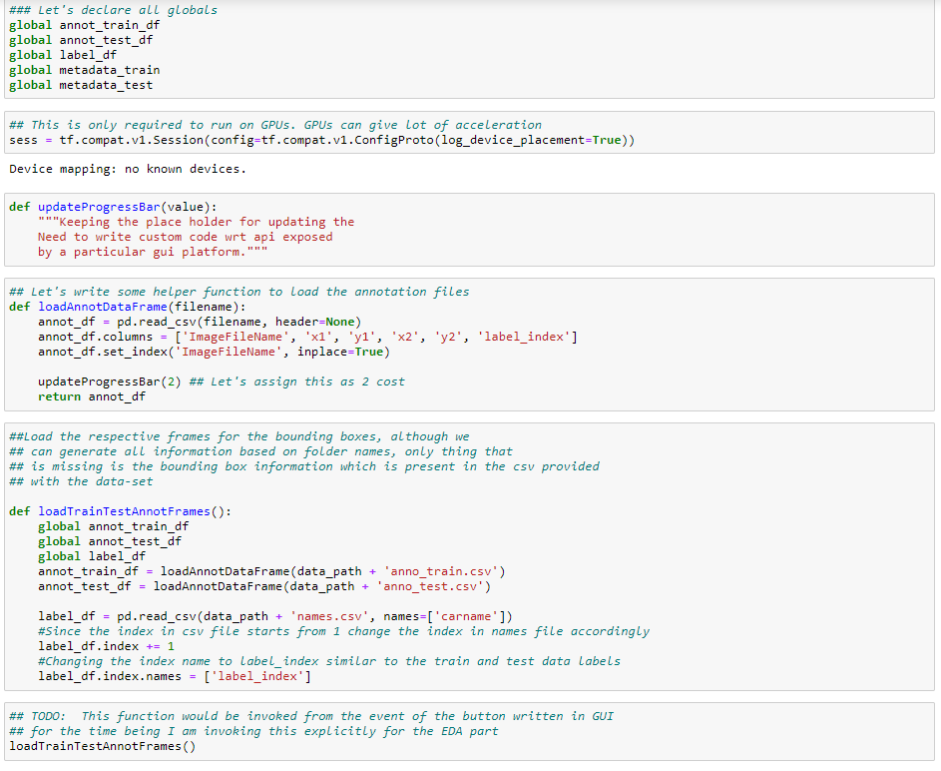
Loading data sets
Image Preprocessing
Normalization
Augmentation
Normalization by pixel of each image
Normalization of all image
Import necessary python library
UI
VGG16
Mobilenet
EfficientnetB5
EllificentnetB0
Choose directory where data loaded
Model building
Building loss criteria
IOU: MSE
Categorical accuracy
Load the data
Visualize the data
Hyper parameter tunning
Cyclic Learning
Progressive unfreezing
Batch number
EDA
Model evaluation

Slide 6
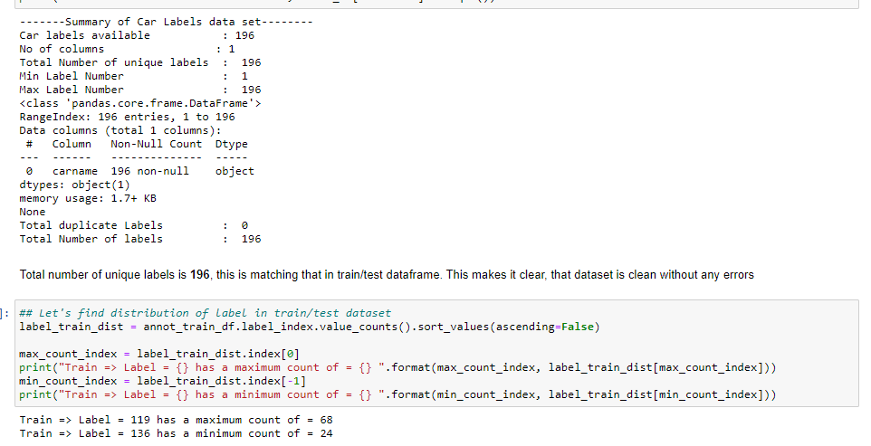
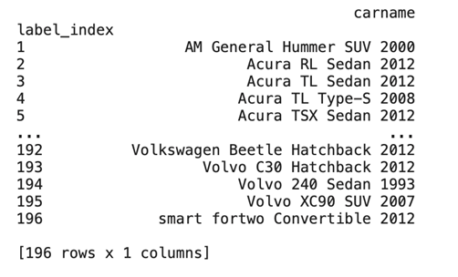
Class Identification
Image Preprocessing
Normalization
Augmentation
Normalization by pixel of each image
Normalization of all image
Import necessary python library
Class name
UI
VGG16
Mobilenet
EfficientnetB5
EllificentnetB0
Choose directory where data loaded
Model building
Building loss criteria
IOU: MSE
Categorical accuracy
Load the data
Visualize the data
Hyper parameter tunning
Cyclic Learning
Progressive unfreezing
Batch number
Total number of classes: 196
In training set Label 119: maximum count 68
In training set class no# 136: minimum count 24
EDA
Model evaluation

Slide 7
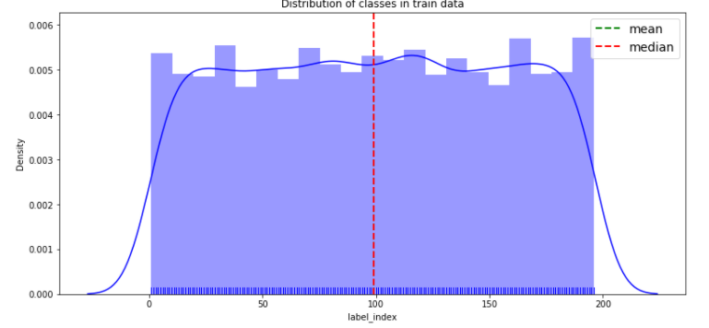
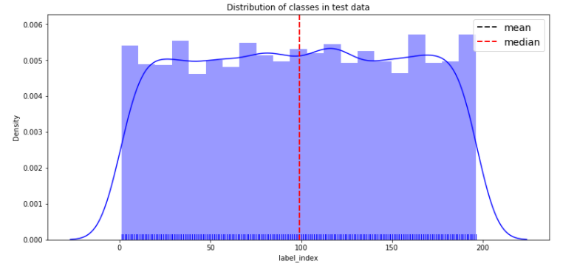
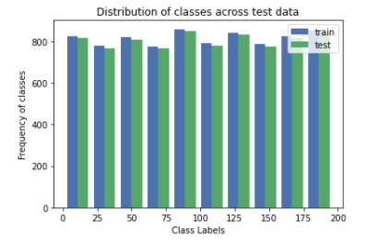
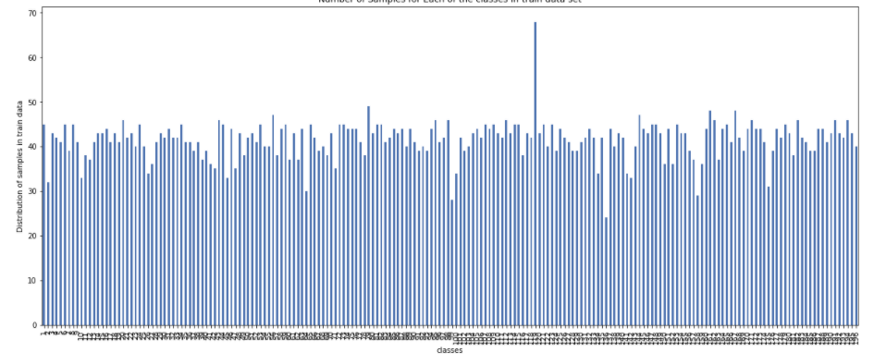
Visualization of datasets
Train Data
Normalization
Augmentation
Normalization by pixel of each image
Normalization of all image
Test Data
Import necessary python library
Image Preprocessing
UI
VGG16
Mobilenet
EfficientnetB5
EllificentnetB0
Choose directory where data loaded
Model building
Building loss criteria
IOU: MSE
Categorical accuracy
Load the data
Visualize the data
Hyper parameter tunning
Cyclic Learning
Progressive unfreezing
Batch number
EDA
Model evaluation
Train and Test dataset : 50:50 Split – Slight Imbalance

Slide 8
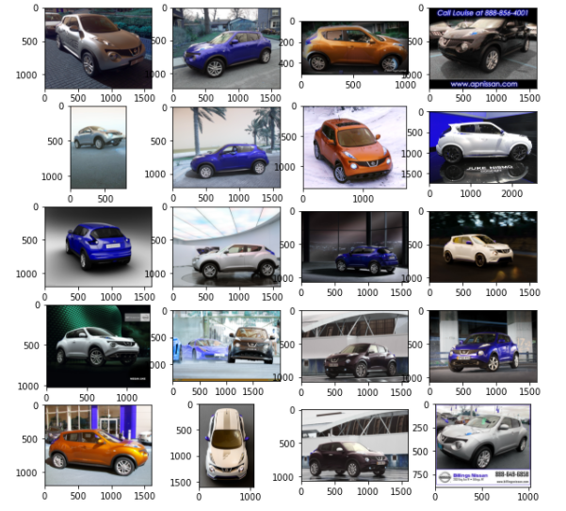
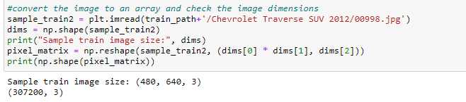
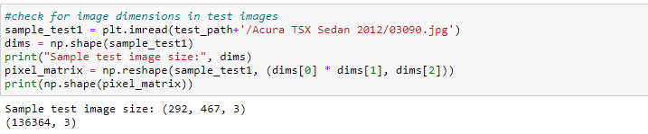
Data Visualization
Image Preprocessing
Normalization
Augmentation
Normalization by pixel of each image
Normalization of all image
Import necessary python library
Class name: Nissan
UI
VGG16
Mobilenet
EfficientnetB5
EllificentnetB0
Choose directory where data loaded
Model building
Building loss criteria
IOU: MSE
Categorical accuracy
Load the data
Visualize the data
Hyper parameter tunning
Cyclic Learning
Progressive unfreezing
Batch number
Sample train image size 480X640 with RGB
Sample test image size 292 X 467 with RGB
EDA
Model evaluation
Each of the image in the same class has different size.
The images are taken from different views/directions

Slide 9
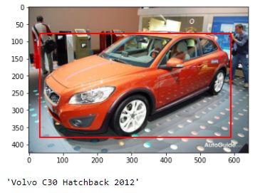
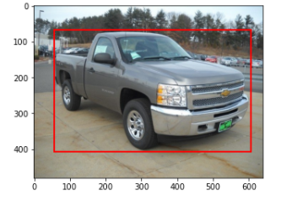
Car class with bounding box with annotation
Image Preprocessing
Normalization
Augmentation
Normalization by pixel of each image
Normalization of all image
Import necessary python library
UI
VGG16
Mobilenet
EfficientnetB5
EllificentnetB0
Choose directory where data loaded
Model building
Building loss criteria
IOU: MSE
Categorical accuracy
Load the data
Visualize the data
Hyper parameter tunning
Cyclic Learning
Progressive unfreezing
Batch number
Class annotation and bounding box coordinates has been imported from anno.csv files
EDA
Model evaluation

Slide 10
EDA Summary
Approximately 50:50 Split across train and test data set
No missing values since it was images , hence no imputation or data removal required
One of the labels had the label name differently specified than the folder name and this had to be managed with code.
Images with different dimensions(aspect ratios) needed resizing and the corresponding bounding boxes to be resized
Images at different zoom levels and different views- cropped and resized data while training
Used Albumentations instead of Keras data generator for image augmentation
Image Preprocessing
Normalization
Augmentation
Normalization by pixel of each image
Normalization of all image
Import necessary python library
UI
VGG16
Mobilenet
EfficientnetB5
EllificentnetB0
Choose directory where data loaded
Model building
Building loss criteria
IOU: MSE
Categorical accuracy
Load the data
Visualize the data
Hyper parameter tunning
Cyclic Learning
Progressive unfreezing
Batch number
EDA
Model evaluation

Slide 11
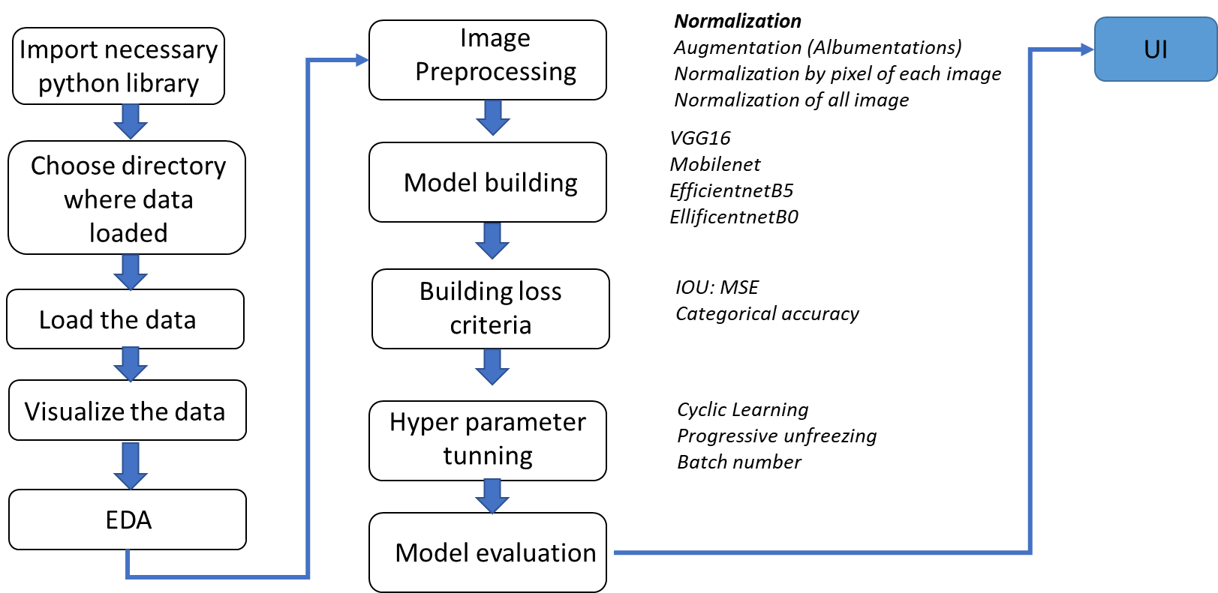
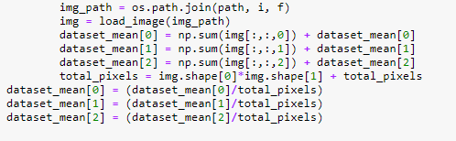
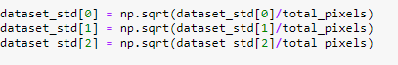
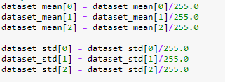
Normalization
Dataset mean value for each channel: (0.4496688992557394, 0.45574301638171105, 0.46740698326736607)
Dataset std. deviation for each channel:
(0.30231249701424134, 0.2940775677688968, 0.2954279952860252)
Calculate each channel mean for all the images
Calculate each channel stdev for all the images
Normalize std/mean by 255

Slide 12
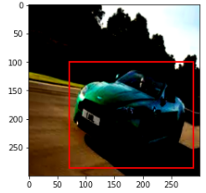
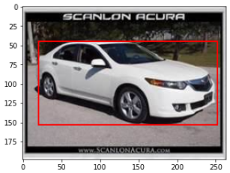
Data Augmentation
There are different ways to do image augmentation such as:
Rotation
Flip
RandomBrightness
Rotation
Flip
RandomBrightness
Different types of normalization with randomly chosen augmented image

Slide 13
Algorithms
Image Preprocessing
Algorithms attempted:
Convolution based network for classification – MobileNet V2
Anchor Based Algorithms- SSD
Anchor Less models for Classification and Regression – MobileNetV2, Efficient Net B5, Yolo V3
Approaches
Transfer learning on pre-trained models
Tensor flow object detection API
Model Building

Slide 14
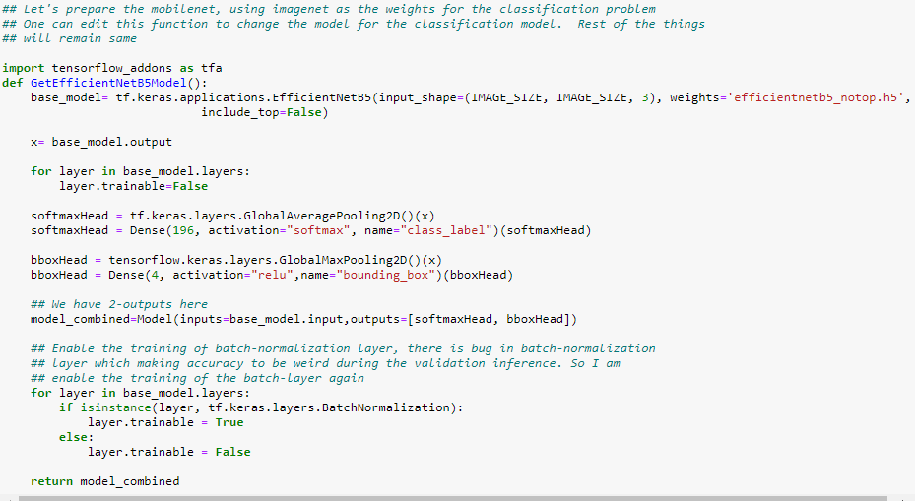
Model Building
In this section different transfer learning model will be evaluated
Transfer learning model : Efficientnet B5
Weights : efficientnetb5_notop.h5
Added new layer : Dense layer(no. of classification) with softmax activation
Bounding box with relu activation
Enabled the Training of the Batch Normalization layer
Without enabling, classification accuracy was low
Issue due to pre-trained weight std/mean was being used and not the batch weight which can be different, so enabled the training for this

Slide 15
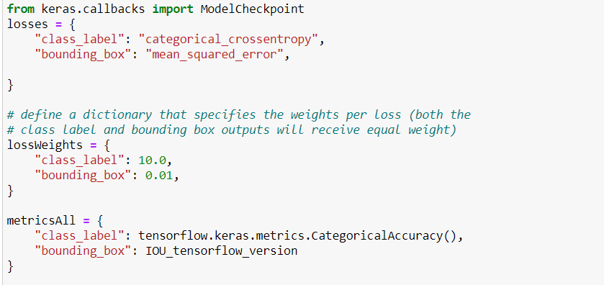
Building loss criteria
Loss Function
Classification loss : Categorial_crossentropy
Bounding box : Mean Square Error
Scaling of loss function : Finding car classification is more important than bounding box as there no other image is visible in the data set. Categorical loss : MSE significance 100:1
Focal loss has not be considered as we have seen the classes are balance in train and test data set and there is no multilabel classification in single image

Slide 16
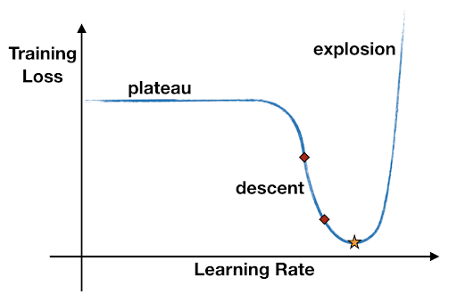
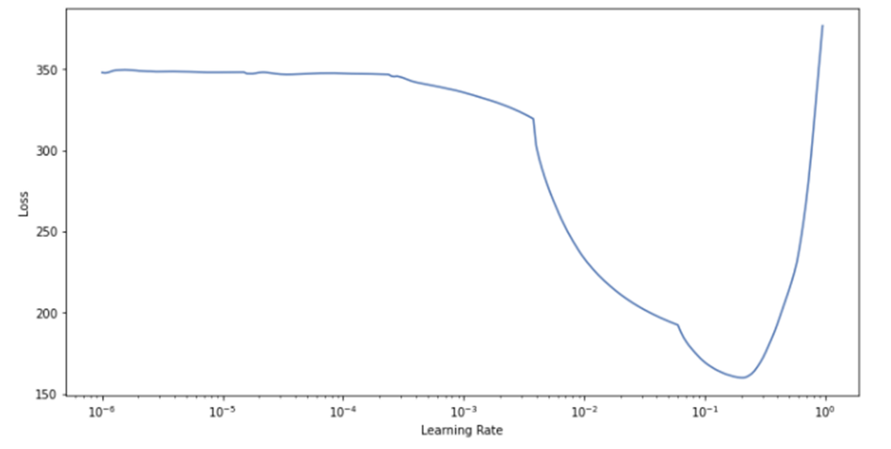
Hyper Parameter Tuning: Learning Rate finder
Inspired from Leslie N. Smith paper Ref: https://arxiv.org/abs/1506.01186 [2]
Learning rate finder
Why Cyclic Learning ?
The learning rate is a hyperparameter that controls
Weights of the network with respect to the loss gradient.
Measures how much a model can “learn” from a new mini-batch of training data.
The higher the learning rate, the bigger the steps we take along the trajectory to the minimum of the loss function, where the best model parameters are.
The recommended minimum learning rate is the value where the loss decreases the fastest (minimum negative gradient),
0.006
LR finder shows the optimum value of learning rate ~0.006

Slide 17
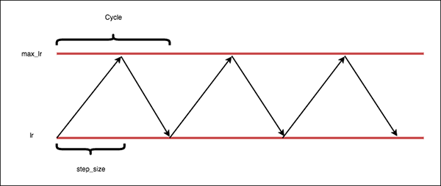
Hyper Parameter Tuning: Cyclic Learning
Inspired from Leslie N. Smith paper Ref: https://arxiv.org/abs/1506.01186
Why Cyclic Learning ?
Cyclical learning rates seek to handle training issues when learning rate is too high or too low. It includes includes three modes — “triangular”, “triangular2”, and “exp_range”.
Parameter for cyclic learning : base_lr=0.001, max_lr=0.006, step_size=2000.
Max learning has been found from learning rate finder
Difference has been found on accuracy by using cyclic learning

Slide 18
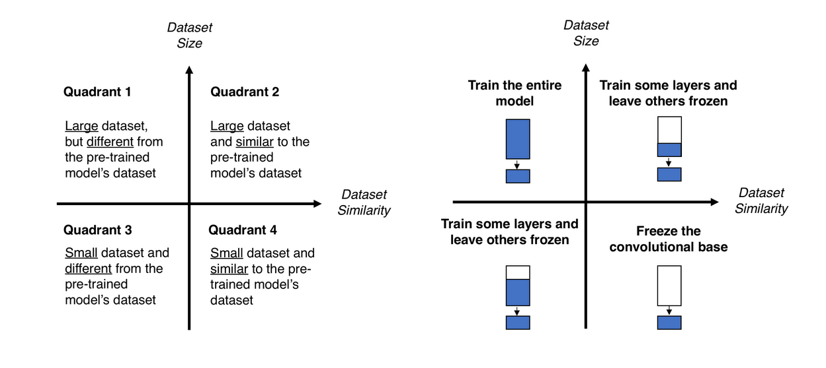
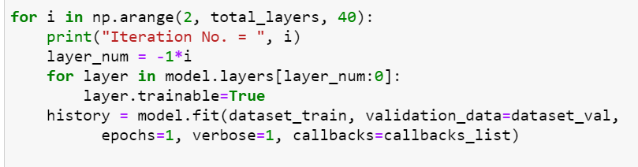
Hyper Parameter Tuning: Progressive unfreezing
Ref: https://arxiv.org/pdf/1706.04983.pdf. [3]
Progressive Unfreezing parameter
Skipped every 40 layer stating for 1st layer
Progressive unfreezing with right learning rate improved the accuracy~30%

Slide 19
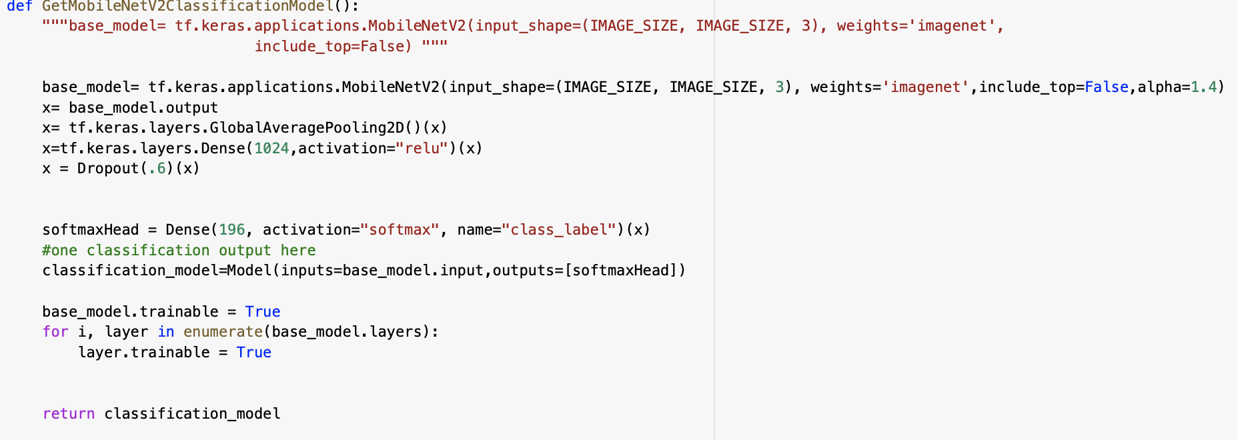
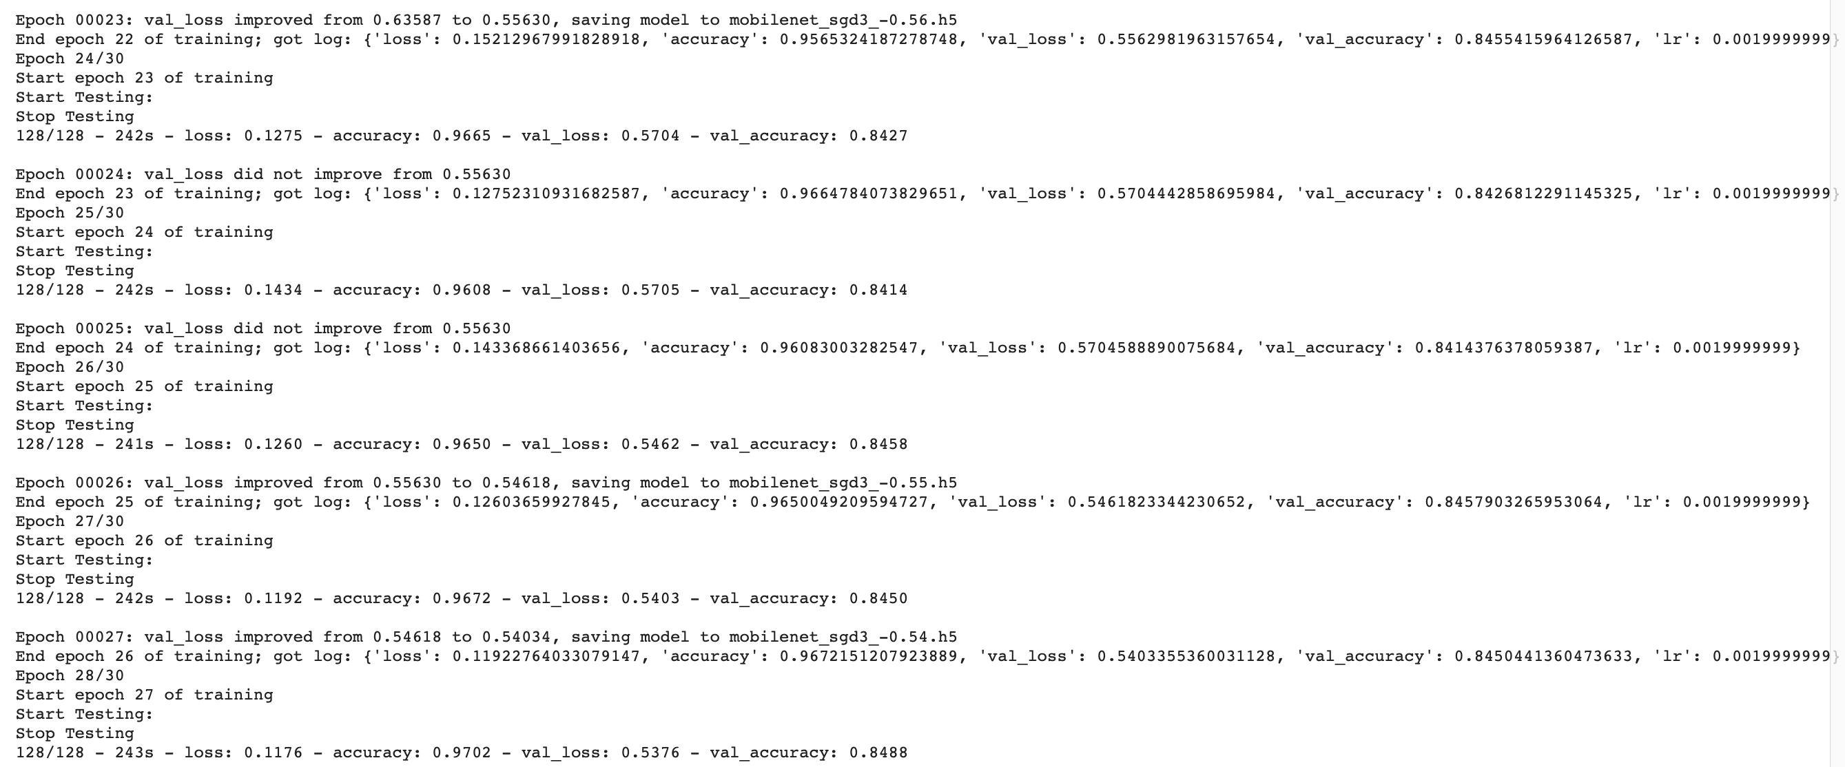
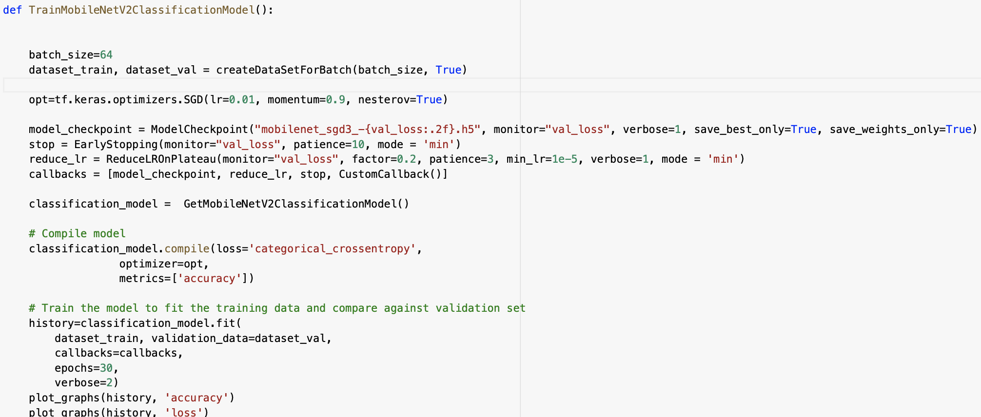
Initial Models
Mobile Net V2- Classification Only
Can achieve classification with Mobile net.
Need further fine tuning for improving accuracy and include bounding box for localization.
Could explore MobileNet based models as feature extractor

Slide 20
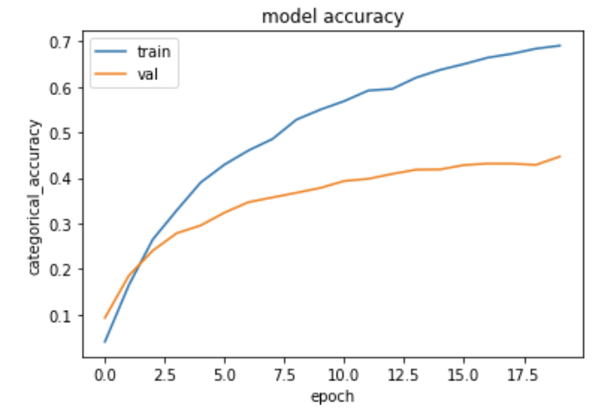
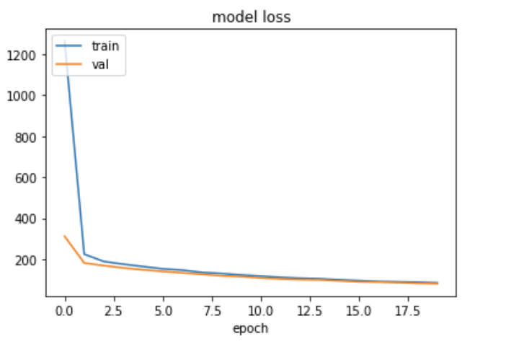
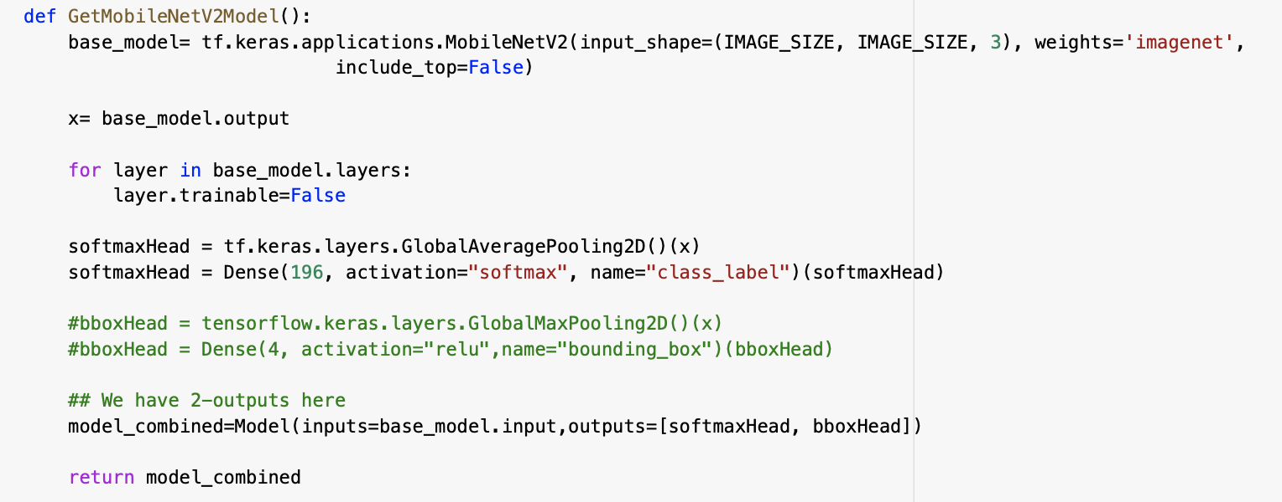
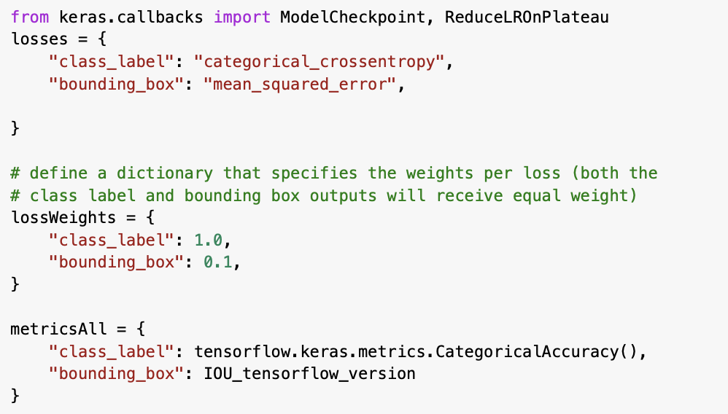
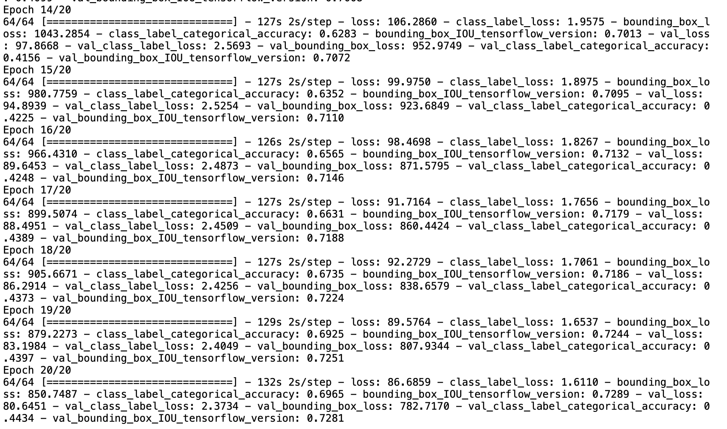
Initial Models
MobileNet V2- Classification and Localization
Accuracy Low .
Need further fine tuning to use this model

Slide 21
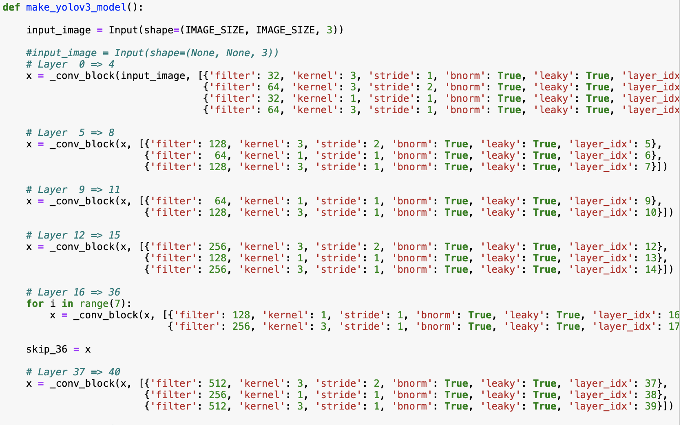
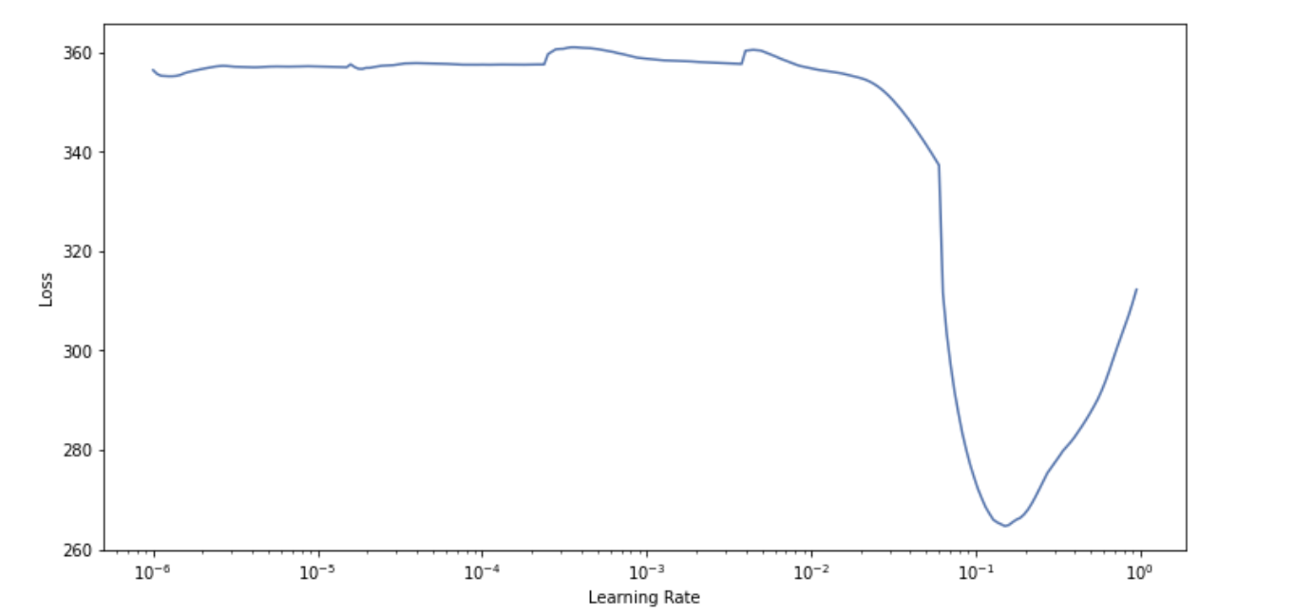
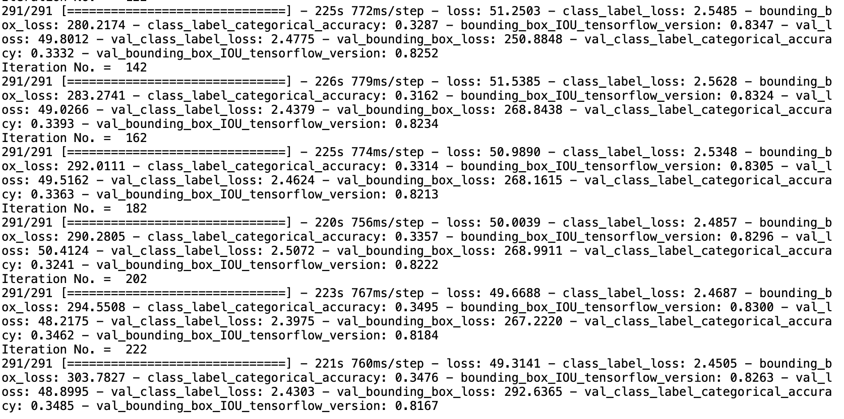
Initial Models
Yolo v3 Based
Though IOU reasonably good, accuracy Low . Will need further fine tuning to use this model

Slide 22
Initial Models
SSD- Mobile Net V2
Using Tensorflow Object Detection API
Pipeline Configuration Changes
Import the necessary libraries and TF Object Detection API
Load images and annotations
Prepare utility to create Tensor flow records
Create label map file
- Configure training /evaluation pipeline
Identify evaluation metrics :coco
Train and evaluate the model (subset of data and full data)
Batch size changed, classification loss changed from sigmoid to sigmoid focal ,optimizer changed and many other parameters modified to decrease the total loss starting from around 112 to bring it down to less than 2.
Some of the parameters represented below:
model.ssd.num_classes = 196
Box_predictor:initializer=random_normal_initializer
classification_loss: weighted_sigmoid_focal gamma: 1.5 alpha: 0.25
optimizer : adam_optimizer
train_config.num_steps = 5000
model.ssd.num_classes = 196
eval_config.num_examples = 10
loss.classification_weight=10
loss.localization_weight=0.2.
Achieved significant reduction in loss
Classification not appropriate and the bounding boxes were not getting plotted correctly. Hence not pursing.
This model is not included in the final UI build

Slide 23
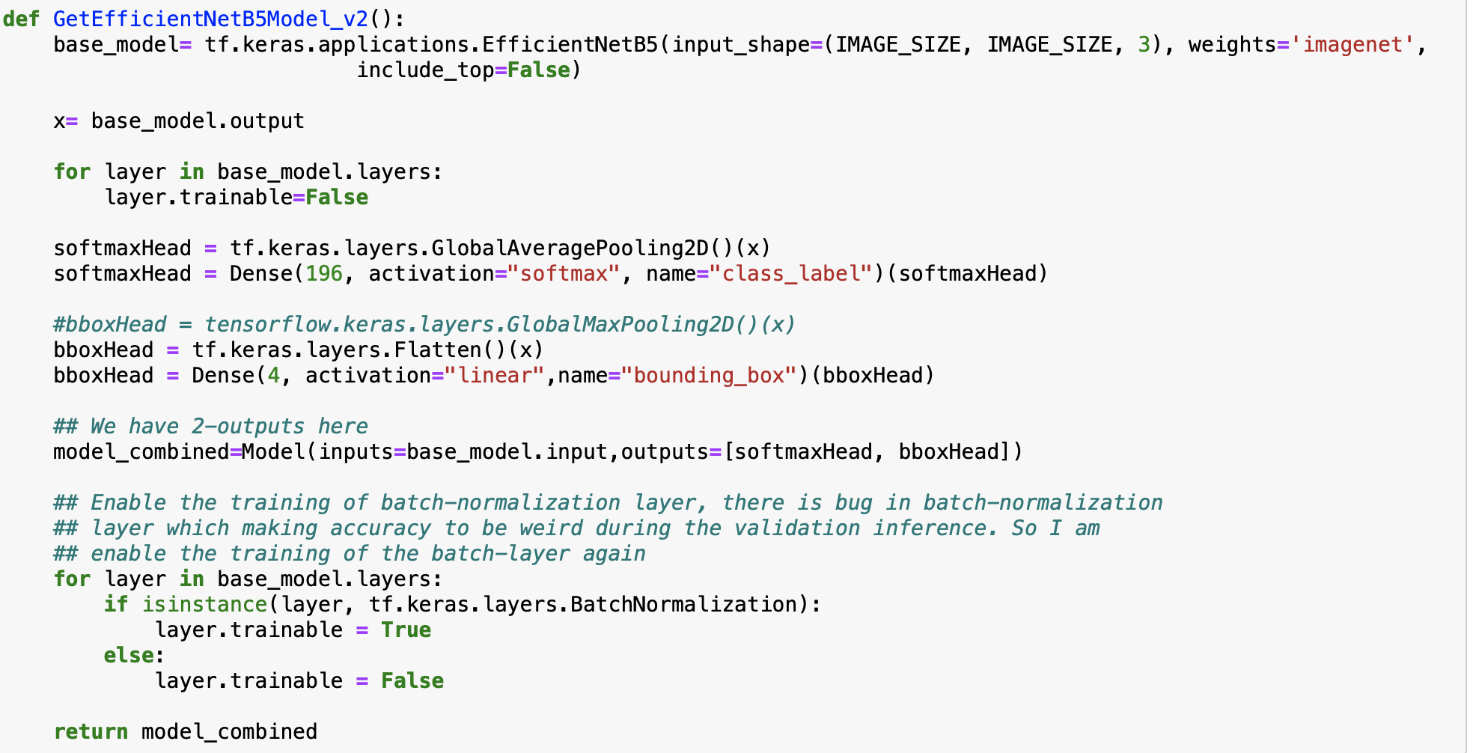
Final Solution
Code Snapshot – Model Definition

Slide 24
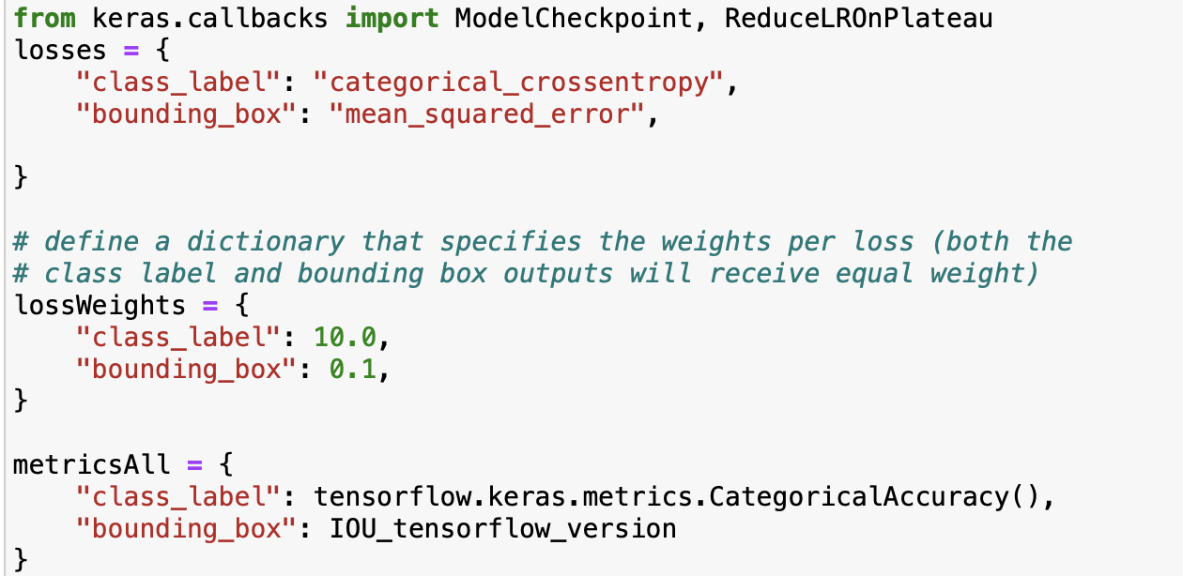
Final Solution
Code Snapshot-Loss Functions and Weights

Slide 25
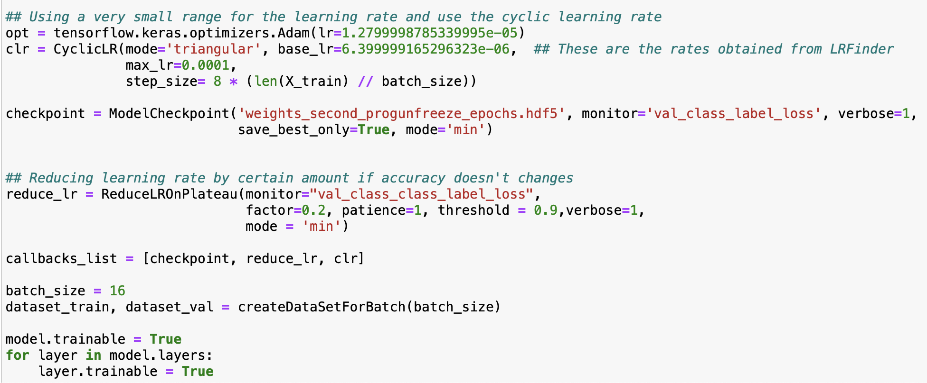
Final Solution
Code Snapshot– Using Cyclic Learning Rate

Slide 26
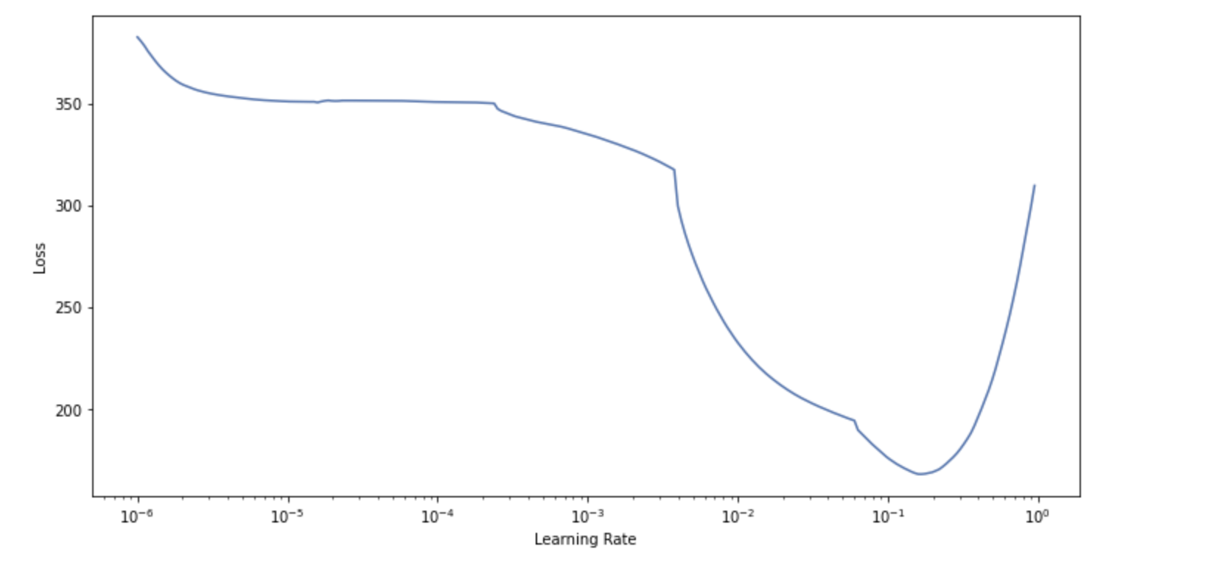
Final Model
Fine tuning in a nutshell
Learning Rate Finder (step 2)
Load EfficientNetB5 model with pretrained weights based on imagenet
Use lr-finder to find the right learning rate range.
With Max Lr =0.1 Min Lr=0.01 fine-tune pre-trained network.
Freeze all the layers except enable the training of the BatchNormalization layer
GlobalMaxPooling2D added prior to predicting the bounding boxes replaced by Flatten layer to avoid the issue with loss of spatial information on the image and the shift in bounding boxes.
Train the above model for 20 epochs, store the weights with checkpoint callback
Load the weights found in previous step for the best case scenario
Unfreeze all layers and choose a very small lr as a starting learning rate
Use Cyclical Learning Rate for fine tune.
Code – Progressive unfreezing (step 4)
for i in np.arange(2, total_layers, 40):
print("Iteration No. = ", i)
layer_num = -1*i
for layer in model.layers[layer_num:0]:
layer.trainable=True
history = model.fit(dataset_train, validation_data=dataset_val,
epochs=1, verbose=1, callbacks=callbacks_list)

Slide 27
Model Evaluation
Measures :
Classification : Categorical Accuracy to measure how well the predicted labels match the actuals
Localisation:
- Intersection Over Union(IOU) for bounding boxes OR
-mAP- Mean Average Precision
Loss: Training and Test Loss will be monitored

Slide 28
Model Evaluation
Model | Classification Test | Classification Train | Bbox (Test) | Bbox(Train)
Mobilenet V2 (Classification only) | Accuracy: 0.85 Loss:0.5 | Accuracy: 0.96 Loss: 0.12 | NA | NA
Mobilenet V2 | Accuracy: 0.44 Loss: 2.374 | Accuracy: 0.70 Loss: 1.6 | IOU:0.728 Loss: 7281 | IOU: 0.7289 Loss: 850
EfficientnetB5 with efficientnet b5 weights | Accuracy: .867 Loss: 0.53 | Accuracy: 0.99 Loss: 0.02 | IOU:0.89 Loss:118.65 | IOU: 0.91 Loss: 65.92
SSD-MobileNet-V2 | Class Loss:1.12 Total :1.8 | Total Loss:1.6 | Loss: 0.209 mAP@IOU 0.5=0 | Total Loss:1.6
Yolo V3(anchorless) | Accuracy:0.4003 Loss:2.267 | Accuracy: 0.406 Loss:2.28 | IOU:0.761 Loss: 937 | IOU:0.791 Loss: 32.0
Model building
Monitor Loss
Hyper parameter tuning
Model Evaluation

Slide 29
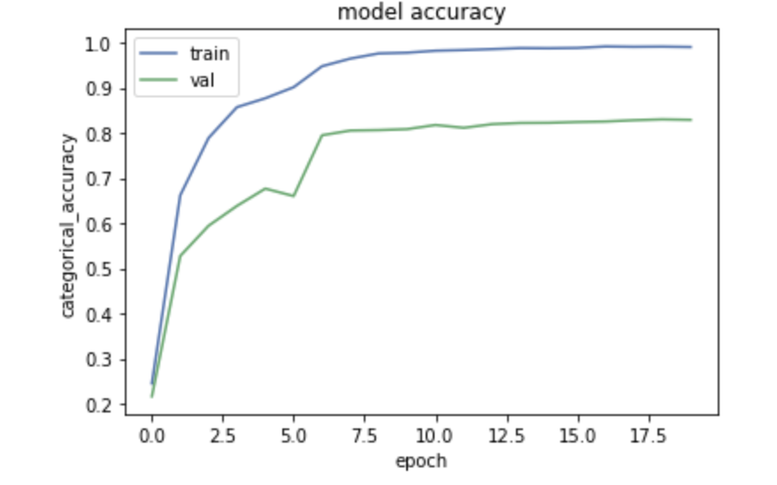
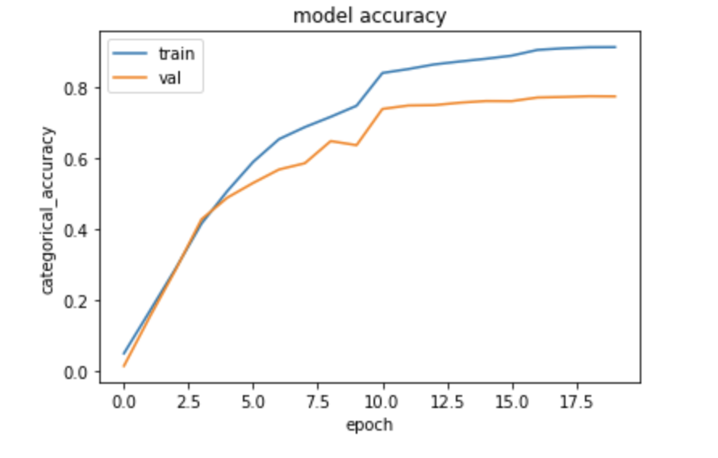
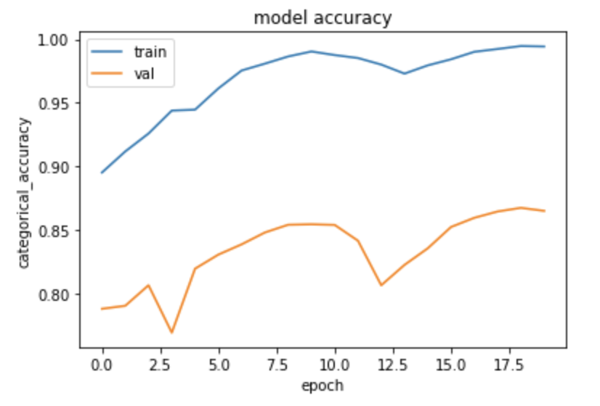
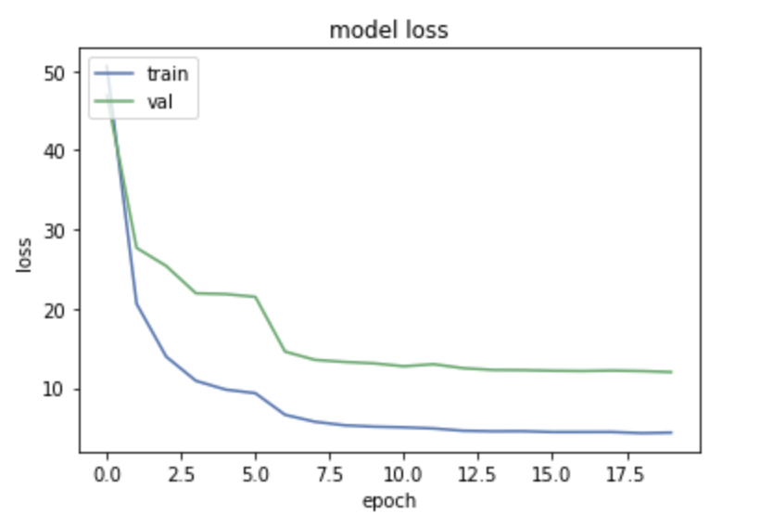
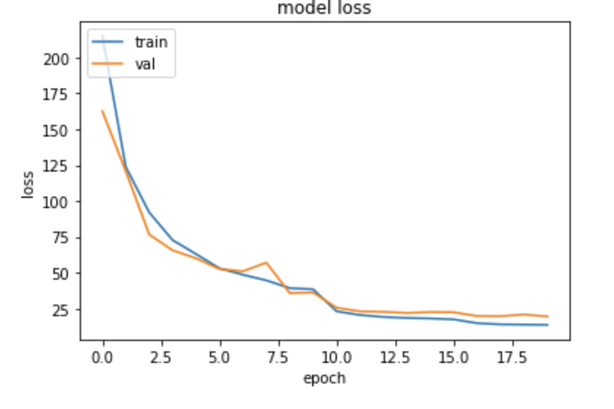
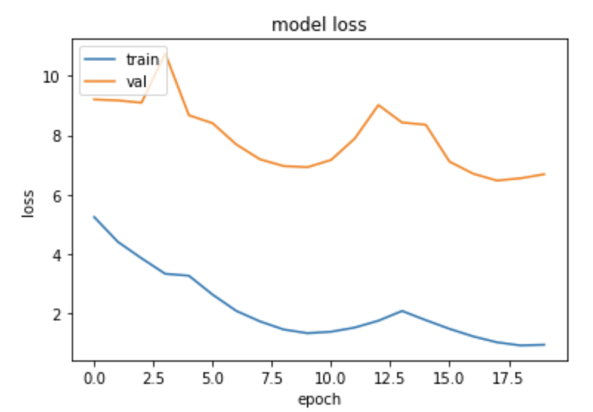
Model Evaluation
Comparison of the final solution(EfficientNetB5) –Improvements Achieved
Initial Learning rate=0.01
identified by LR finder
Freeze all layers except BN +Flatten Layer
Previous steps + Cyclic LR

Slide 30
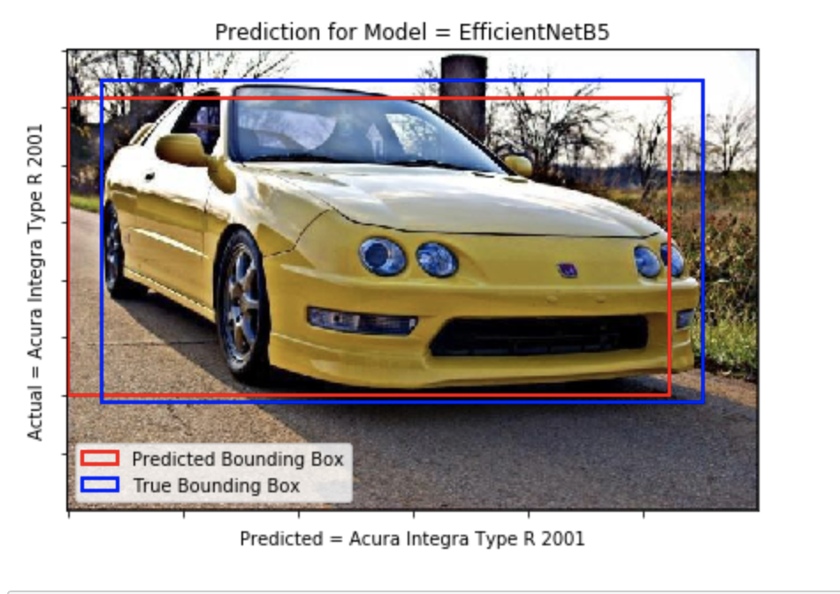
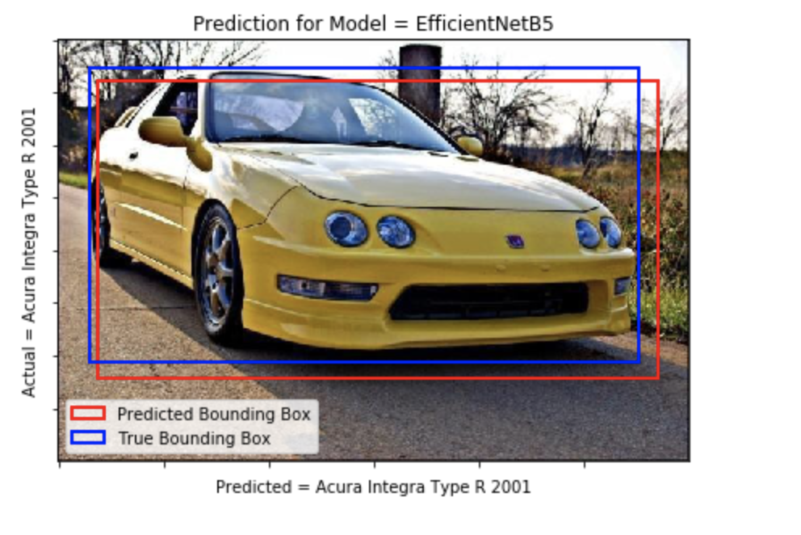

Model Evaluation
Comparison of the final solution(EfficientNetB5) –Improvement Achieved
LR Finder
Freeze all layers except BN +Flatten Layer
Unfreeze all layers + Flatten Layer+Cyclic Learning Rate
Correct labels
issue with bounding boxes
Correct Labels
Better Bounding boxes
Correct Labels
Better Bounding boxes

Slide 31

Model Evaluation
Visualizations using STREAMLIT – Comparison across models

Slide 32

Model Evaluation
Confusion Matrix for final solution:

Slide 33


Model Evaluation
Snapshot of Classification Matrix for final solution

Slide 34
User Interface
Approach:
Evaluate Tools/ Create Prototype
Implement entire ML steps
Model building
Tools Evaluated for UI for the current solution
Monitor Loss
 | Simplicity | Documentation | Ease of Coding | All ML Phases
Streamlit | Good | Good | Easy | Good
Gradio | Good | Not Good | Easy | Not good
Flask with html | Not Good | Good | Not Easy | Good
Hyper parameter tuning
Model Evaluation
Final Choice: Streamlit version 0.77
UI
** Choice of tool may have been biased by our limited knowledge and time

Slide 35

User Interface
Options available:
EDA- Load Data and Perform Exploratory Data Analysis
MapData- Map Train and Test Data to annotations and populate data structures
Display Images – Select Images from train or test and display with bounding boxes , display images belonging to a category
Train Model- Train any one of the models from the drop down list
Test Model- Test using the pretrained models
Prediction- Predict on test/unseen data using pretrained models and provide comparison across models
HOME PAGE
Watch the Demo Video , at the link below:
https://drive.google.com/file/d/1u-F9UEnq4t-CLNYmMPTnKQq0UhzJrycV/view?usp=sharing

Slide 36




User Interface
Exploratory Data Analysis
Map Annotations

Slide 37

User Interface
Checking Images

Slide 38

User Interface
Visualizing Prediction – Single Model

Slide 39
User Interface
Visualizing Prediction – Multiple Models

Slide 40
User Interface Installation
Requirements:
Python 3.7 or above
Streamlit v 0.77
Pandas 1.2.1
Numpy 1.19
Tensorflow 2.4
Sklearn 0.24
Matplotlib
Albumentations 0.5.2
Code file : AIML_Capstone_CV_CarDetection_MarsGrp2CV2_UICode.py
Download Pre-trained model weights :
https://drive.google.com/drive/folders/1tyxRuRLw3Ccw0Q7-hoDOqj4pJfdFml8p.
In case these are not downloaded, it will automatically be downloaded in working directory but will take some time
To Make Predictions Using the Pre-trained Models:
Download the Streamlit Code file
Check access to the Pre-trained model weights folder. The streamlit code will automatically download the weights to the directory.

Slide 41

User Interface Run
After downloading the source please change the following paths for the dataset in the source file
Run the Streamlit code file using the command
% streamlit run AIML_Capstone_CV_CarDetection_MarsGrp2CV2_UICode.py

Slide 42
Summary
Objective: To create a Deep Learning based model for Car detection
Tasks completed to achieve this:
Images imported and mapped to its classes and annotations made
Exploratory Data analysis and steps for preprocessing identified
Preprocessing of data – normalization and resizing of images and bounding boxes done along with data augmentation to improve model performance and reduce generalization error
Trained and Tested a set of CNN based models and other hybrid architectures and models evaluated based on relevant performance measures .
Learning Rate Finder, Cyclic Learning Rate, progressive unfreezing, batch size , dropout techniques applied to improve performance
EfficientNetB5 gave the best results in terms of classification and localization (>85%). Best Model pickled and saved
User interface created using Streamlit for loading data and visualization, training and inference based on pretrained models and provide comparison across the models.

Slide 43
Implications of solution to business domain and Limitations
The solution can be used in various business applications to identify cars by make or model based on images captured.
EfficientNetB5 model was able to predict with around 87% accuracy and IOU of 0.89
Limitations:
The current solution is able to achieve only overall accuracy 87% with an IOU of .89. The precision varies from 0.7 to greater than 0.9 and similarly with recall which indicates there is still possibility of Type 1 and Type 2 errors, indicating there is still window for improvement .
What can be done to enhance the solution:
Use explainability methods to help interpret the behavior of the model and understand how classification is being performed
Use more images / images that are distinct from the existing images and retrain the existing solution

Slide 44
Reflection
What did we learn:
Learnt how preprocessing the inputs using augmentation is as important as finetuning the parameters of the model to achieve good performance.
Learn to use pretrained models for prediction, and improve performance by applying techniques like cyclical learning rate and progressive unfreezing of layers
Tried various models for object detection and compared their performance to pick the best one
Building a model using pretrained CNN features is effective and easier than building a deep learning network from scratch
Various User Interface options for Deep Learning Models

Slide 45
Reflection
What we could do differently:
Given more time for model tuning and with better processor capabilities , could try and improve the performance of the trained model and could explore other state of the art models
Plan for the preprocessing requirements for each type of architecture
Use PyTorch instead of limiting to Keras and explore docker or other tools for containerization and user interface creation.
More diligence on data and creating new set of classes if required. Example: insignificant difference in appearance across the car models could be managed by checking similarity index for the different labels across model ,make or year and re-classify if necessary .
Detailed error analysis and exploring explainability: Identify why images had wrong predictions and or identify distinct images and retrain the model to improve performance.

Slide 46
Citations
[1] Jonathan Krause, Michael Stark, Jia Deng, Li Fei-Fei (2013) 3D Object Representations for Fine-Grained Categorization. 4th IEEE Workshop on 3D Representation and Recognition, at ICCV 2013 (3dRR-13).
[2] Smith, L. (2017, April 04). Cyclical learning rates for training neural networks. Retrieved February 28, 2021, from https://arxiv.org/abs/1506.01186
[3] Andrew Brock, Theodore Lim, J.M. Ritchie ,Nick Weston (2017,June 18). Freezeout: Accelerate Training by Progressively Freezing Layers
[4] https://www.pyimagesearch.com/2019/08/05/keras-learning-rate-finder/
[5] http://blog.datumbox.com/the-batch-normalization-layer-of-keras-is-broken/

Slide 47
Thank You
Prepared by:
Ankit Garg
Prateek Gupta
Sandip Maity
Sugathri N
Sreelatha R

